Slide 1
Unit 7 Security

Slide 2
What is Security?
Security refers to protecting and securing computers and their related data, networks, software, hardware from unauthorized access, misuse, theft, information loss, and other security issues.
It involves protecting sensitive information stored on computers, as well as ensuring that the systems and networks are secure against attacks and unauthorized access.

Slide 3
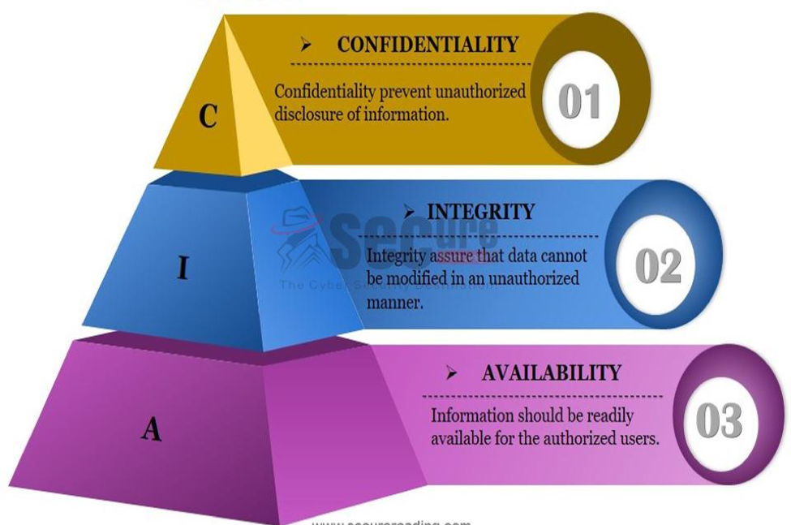

Basic Components of Security
Figure: CIA Triad

Slide 4
Basic Components of Security
Confidentiality:
It refers to the protection of sensitive information from unauthorized access or disclosure.
Confidentiality ensures that sensitive information is only accessible to authorized individuals and is not disclosed to unauthorized parties.
2. Integrity:
It refers to the assurance that data and information is accurate, complete, and consistent, and has not been altered or corrupted in any way.
Availability:
It refers to the assurance that authorized users have access to the information and resources they need, when they need it.
Availability ensures that systems, networks, and resources are functioning properly and are accessible to users(authorized) who need them.

Slide 5
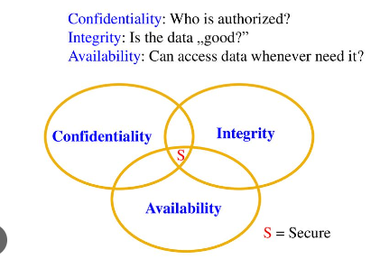
Basic Components of Security

Slide 6
Security threats
Security threats are potential attacks or dangers to the security of computer systems, networks, and data.
The actual violation of security is called an attack.
Types of Security Attacks
Passive Attacks
A passive attack attempts to learn or make use of information from the system but does not affect system resources.
Active Attacks
An active attack attempts to alter system resources or affect their operation.

Slide 7
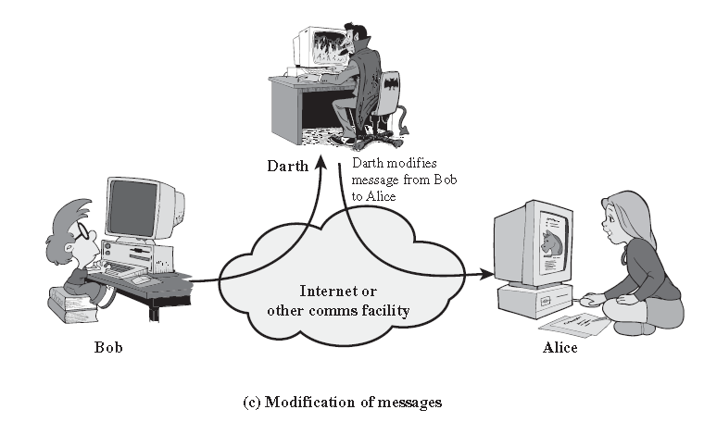
Security threats
Snooping:
Snooping refers to the unauthorized access and monitoring of private information, such as emails, messages, or other forms of communication.
Modification:
It refers to the unauthorized alteration or tampering with data or information.

Slide 8
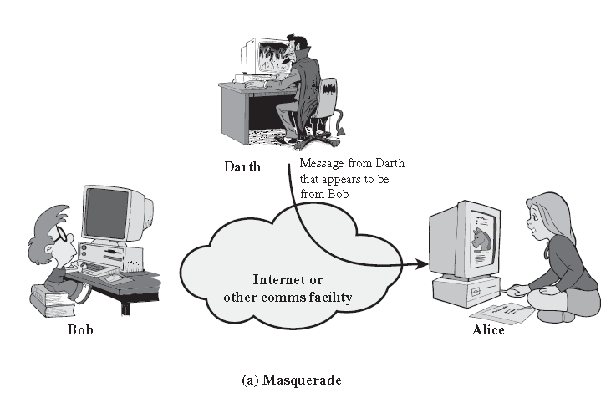
Security threats
Masquerading: It refers to the act of posing as someone else in order to gain unauthorized access to information or systems.

Slide 9
Security threats
Repudiation of origin:
It refers to the denial by a user or entity that they were the source of a particular message, action, or transaction.
This can occur in various forms, such as denying the origin of an email, denying the source of a payment, or denying the source of an order.
Denial of receipt:
It refers to the act of denying that a message, action, or transaction was received or received correctly.
This can occur in various forms, such as denying receipt of an email, denying receipt of a payment, or denying receipt of an order.

Slide 10
Security threats
Delay:
It refers to the act of delaying or slowing down the delivery or processing of information or transactions.
This can occur in various forms, such as delaying the delivery of an email, delaying the processing of a payment, or delaying the fulfillment of an order.
Denial of Service (DoS):
It is a type of cyber attack that aims to disrupt the normal functioning of a computer system, network, or application by overwhelming it with excessive traffic or requests.
The goal of a DoS attack is to prevent legitimate users from accessing the targeted system or service, rendering it unavailable.

Slide 11
Cryptography
Cryptography is the technique of converting plain text into cipher text and vice-versa.
It is technique of securing information and communications through use of codes so that only those person for whom the information is intended can understand it and process it.
Original message before transformation → Plaintext.
An Encryption algorithm transforms → Plaintext to Ciphertext.
Decryption algorithm transforms → Ciphertext to Plaintext.

Slide 12
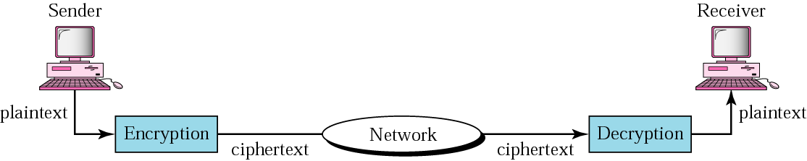
Cryptography

Slide 13
Encryption & Decryption
Encryption is the process of encoding a message or information in such a way that only authorized parties can access it and those who are not authorized cannot.
Decryption is the process of taking encoded or encrypted text and converting it back into text that you or the computer can read and understand (original form).
It is generally a reverse process of encryption.
It decodes the encrypted information so that an authorized user can only decrypt the data because decryption requires a secret key or password.

Slide 14
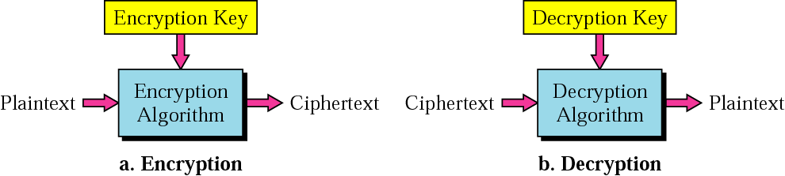
Encryption & Decryption

Slide 15
Types Of Cryptography
In general there are two types Of cryptography:
Symmetric Key Cryptography
One Key Cryptography
Private key Cryptography
Asymmetric Key Cryptography
Two Key Cryptography
Public Key Cryptography

Slide 16
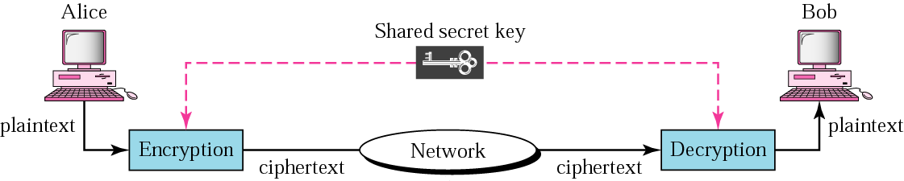
Symmetric Key Cryptography
Symmetric-key algorithms are the algorithms for cryptography that use the same cryptographic keys for both encryption of plaintext and decryption of ciphertext.
Symmetric-key systems are simpler and faster, but their main drawback is that the two parties must somehow exchange the key in a secure way.

Slide 17
Symmetric Key Cryptography
Symmetric-key cryptography is sometimes called secret-key cryptography.
Symmetric-key encryption can use either stream ciphers or block ciphers.
Stream ciphers encrypt the digits or letters of a message one at a time. e.g. Vigenere Cipher.
Block ciphers take a number of bits and encrypt them as a single unit, padding the plaintext so that it is a multiple of the block size. e.g. DES
Blocks of 64 bits are commonly used.
The Advanced Encryption Standard(AES) uses block cipher mode of operation use 128-bit blocks.

Slide 18
Asymmetric key Cryptography
Asymmetric cryptography, also known as Public key cryptography, uses public and private keys to encrypt and decrypt data.
The keys are simply large numbers that have been paired together but are not identical (asymmetric).
One key in the pair can be shared with everyone; it is called the public key.
The other key in the pair is kept secret; it is called the private key.
Eg. RSA

Slide 19
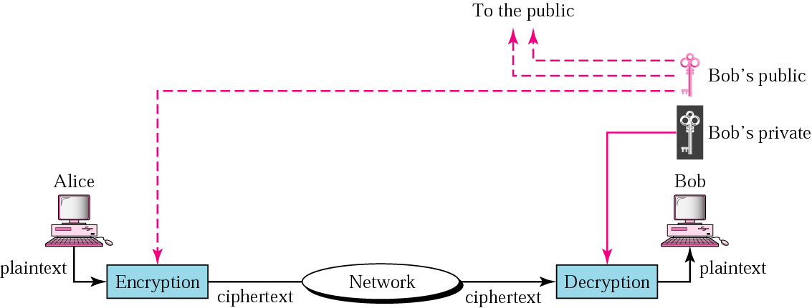
Asymmetric key Cryptography

Slide 20
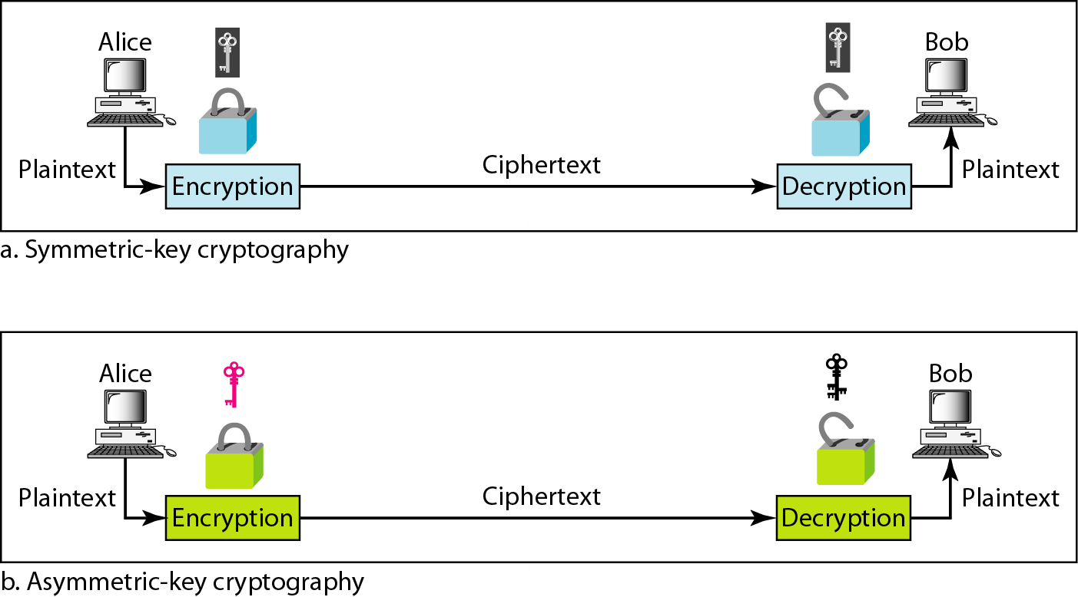
Symmetric/private key and Asymmetric/public key

Slide 21
Protection Mechanism/Security Mechanism
Security mechanisms deal with prevention, detection, and recovery from a security attack.
Prevention involves mechanisms to prevent the computer from being damaged. Detection requires mechanisms that allow detection of when, how, and by whom an attack occurred.
Recovery involves a mechanism to stop the attack, assess the damage done, and then repair the damage.
Security mechanisms are built using personnel and technology.

Slide 22
Personnel are used to frame security policy and procedures, and for training and awareness.
• Security mechanisms use technologies like cryptography, digital signature, firewall, user identification and authentication, and other measures like intrusion detection, virus protection, and, data and information backup.

Slide 23
Access Control List
An access control list (ACL) is a list of rules that specifies which users or systems are granted or denied access to a particular object or system resource.
Access control lists are also installed in routers or switches, where they act as filters, managing which traffic can access the network.

Slide 24
Access Control Matrix
Access control Matrix allows implementing protection model.
This matrix contains rows and columns.
Rows represent the domain. It can be a user, process or a procedure domain.
Columns, on the other hand, represent the objects or resources.
For example

Slide 25
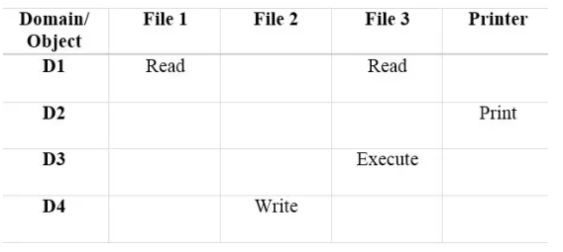
Each entry in the matrix represents access right information.
In the entry access (Di, Oj), Di represents a process in the domain while Oj represents an object or the resource.
According to the above matrix, a process in domain 1 can read File 1.
A process in domain 2 can take printouts, and a process in domain 3 can execute File 3.
Moreover, a process in domain 4 can write to File 2.
This is how the Access Control Matrix operates.

Slide 26
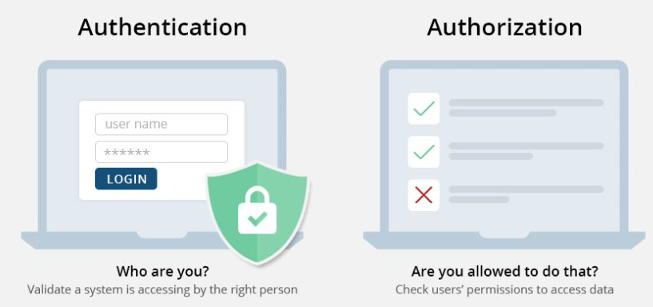
Authentication Vs. Authorization

Slide 27
